Slide 1
Part detection
Badiu Bogdan-Vasile

Slide 2
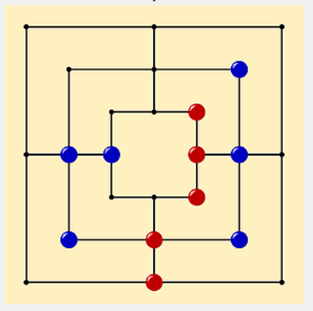
Requirement
Be an image with a target board viewed from above. Find out how many blue pieces there are.
Input parameters : Image
Output parameters : number of blue pieces; the binary image in which the background is black againthe blue pieces are marked in white.

Slide 3
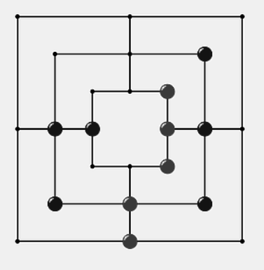
Stage 1
I started by loading the image in the range [0,1]. I transformed from the range [0.255] using the following code:
imag=double(imread(numePoza))/255;
Then I turned the image into grayscale using the following code :
imagGray=0.3*imag(:,:,1)+0.6*imag(:,:,2)+0.1*imag(:,:,3);

Slide 4
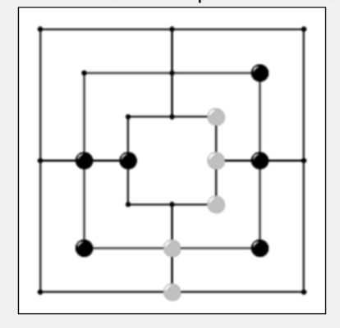
Stage 2
In the second stage I applied a mediation filter that helped me get rid of some details in the image and some light spots.
imagFiltrat = zeros(M,N); %initializare imagine filtrata cu 0
H = [1,2,1;2,4,2;1,2,1];
H = 1/16 * H;
for i = 2 : M - 1
for j = 2 : N - 1
regiune = imag(i-1:i+1,j-1:j+1);
convolutie = sum(sum(regiune.*H));
imagFiltrat(i,j) = convolutie;
end
end

Slide 5
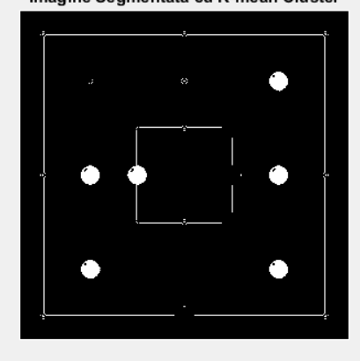
Stage 3
I segmented the image using the K-mean Cluster segmentation algorithm with the initial media values : c1=0.01069;%media minima pe care o scadem din pixel
c2=0.9421;%media minima pe care o scadem din pixel
These were found by testing several values given at random using the code:
c=rand(1,2); c1=min(c); c2=max(c);
Black pixels are transformed back into black after segmentation using the code :
imagBinar(imagGray==0)=0;
It converts pixels from the segmented image to black where black pixels are found in the grayscale image

Slide 6
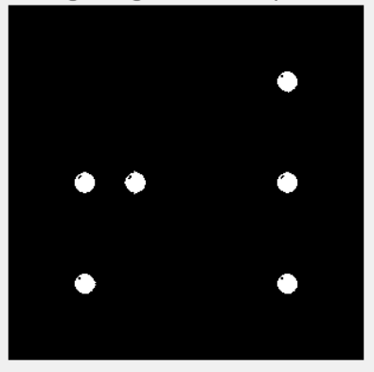
Stage 4
We are looking for a region where we have 6x6 white pixels. This search is done because we assume that in the area where several white pixels are placed next to each other we have a piece and a region of 10x10 pixels is extracted which represents the piece
for i = 5 : M-4
for j = 5 : N-4
if(imagBinar(i-3:i+3,j-3:j+3)==1)
imagSegmentat(i-5:i+5,j-5:j+5)=imagBinar(i-5:i+5,j-5:j+5);
end
end
end

Slide 7
Stage 5
We go through the whole image to leave us in the area where we find the first white pixel to make the region grow.
for i = 1: M
for j = 1 : N
if(imagSegmentat(i,j)==1)
seadRow=i;%locul in care ne plasam/ de unde vrem sa plecam
seadCol=j; %in regiunea noastra
break
end
end
end

Slide 8

Stage 6
Region growing is done to determine a single piece in the segmented image. It counts how many white pixels are in one piece.
for i=1:M
for j=1:N
if(oPiesa(i,j)==1)
contorPiesa=contorPiesa+1;
end
end
end

Slide 9

Stage 7
White pixels in the segmented image are counted to determine all pixels in the pieces.
After determining this counter it is divided by the counter in step 6 (which determines pixels in a single piece) to determine the number of pieces.
for i=1:M
for j=1:N
if(imagSegmentat(i,j)==1)
contorTotal=contorTotal+1;
end
end
end
totalPiese=round(contorTotal/contorPiesa);

Slide 10
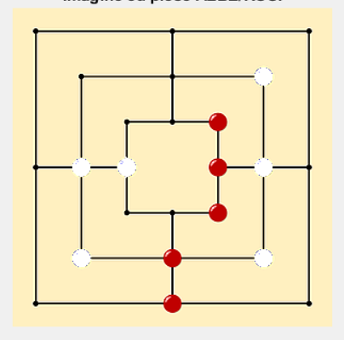
Stage 8
It turns the blue pieces from the original image into white pieces
for i=1:M
for j=1:N
if(imagSegmentat(i,j)==1)
imagFinal(i,j,1)=1;
imagFinal(i,j,2)=1;
imagFinal(i,j,3)=1;
end
end
end

